Slide 1
Formal Methods in Software Engineering

Slide 2
Rule-based systems (RBS)
.
Rule-based system is an automated reasoning technique which captures and refines human expertise.
It automatically performs reasoning for problem solving
Common Applications
  Expert Systems: Medical diagnostics, financial planning.
  Control Systems: Industrial manufacturing
  Compliance & Fraud Detection: Banking and cybersecurity systems, such as flagging transactions based on specific thresholds

Slide 3
Rule-based systems
In general, rule-based systems capture data, analyze data based on the available information and then perform reasoning to produce the desired goals.
A rule-based system is actually an inference based technique that has flexible and dynamic implementation mechanism to solve more realistic and complex problems.
Rule-based system has also played vital roles for modelling business domains. For example, business rules define all legal constraints for the business domains.

Slide 4
Significance of Rule-based systems in formal methods
There are several benefits for adopting rule-based approaches with the formal methods to establish properties of the resulting systems with respect to:
Correctness: This is a measure to check whether a rule-based agent would be able to produce the correct output against all legal inputs or not.
Response Time: This calculates the computational time steps taken by a rule-based device (agent) to generate any output.
Termination: This determines whether a rule-based (device) agent would be able to produce an output at all or not.

Slide 5
Components of Rule-based systems
Rule-base (Knowledge Base): specifies particular type of knowledge bases of the domain in terms of rules where knowledge is encoded into IF-Then rule form.
Temporary Working Memory: stores the facts used by inference engine.
An Inference Engine: performs reasoning to derive new information and/or takes appropriate actions based on the input and rule base.
User Interface: This provides a platform through which input/output signals are sent and received. User interface is optional part of the reasoning process, but it is recommended.

Slide 6
Match-resolve-act
Match-resolve-act has the following phases:
Match: It is the first phase in which facts on the left hand side of the rule (i.e IF) are matched with the contents of the working memory. If facts on the left hand side of the rules are matched then conflict set is generated. This constitutes an instantiation of the rules. In this phase, one rule may have more than one instantiations. Conflict set is generated for the set of all rule instantiations in the memory.
Conflict Resolution: In this phase, conflict resolution strategy selects a single instance or a subset of conflict set for execution from the conflicting set. The set of all instantiations are chosen for the execution in case when reasoning strategy is not applied.
Act: After choosing the single or multiple instantiation(s) from the conflict set, the rule will be executed to infer new information. These actions (newly derived information) are added to the working memory.

Slide 7
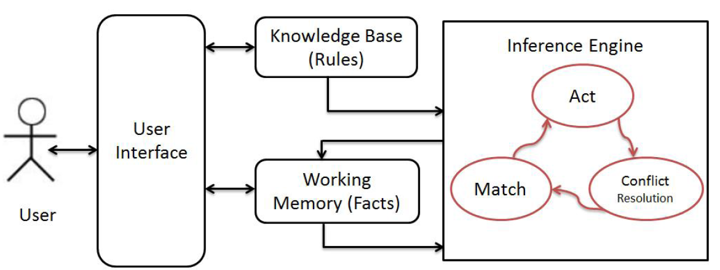
Rule-based systems

Slide 8
Rule-based Programming
Rule-based program have a program consisting of a knowledge base and a working memory.
Knowledge base consists of a set of rules whereas working memory contains the set of facts used by rules.
The generic representation of a rule is given as:
IF <Statements to be evaluated> → THEN <Actions>
where the left hand side of the arrow contains the set of conditions to be evaluated.
When these conditions are matched, the rule will be executed to generate THEN (consequent) part.

Slide 9
Rule-based Reasoning Strategy
Rule-based multi-agent systems may have hundreds of rules to model the domain of complex case scenarios.
When the size of the domain is very large and complex, there is a need to apply some reasoning strategies. For example, some strategies are needed to be applied only on the applicable rules in order to avoid putting on all matching rules instances.
In concurrent systems, each rule is given a rule priority in accordance to its significance in the system. For example, the most important rule is given the highest priority.

Slide 10
Knowledge Engineering in RBS
An engineering discipline that involves integrating knowledge into computer systems in order to solve complex problems normally requiring a high level of human expertise.
Knowledge engineering is the process used to create a RBS:
  Assessing the problem and selecting an appropriate task for the RBS
  Interviewing the domain expert to find out how the problem is solved
  Representing the domain knowledge as facts or rules
  Choosing appropriate development software such as a RBS “shell” and encoding the knowledge within that software
  Testing, revising, and integrating the system in the workplace

Slide 11
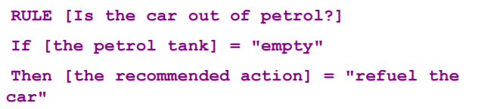
Building Knowledge Base
Knowledge base consists of a set of IF..Then rules, for example;
Because it is made up of rules the knowledge base is sometimes called the rule base

Slide 12
Thanks

